Slide 1
AI ML Practical Exam Presentation Problem Statement: K Nearest Neighbours

Slide 2
Machine Learning
Machine learning is an application of artificial intelligence (AI) that provides systems the ability to automatically learn and improve from experience without being explicitly programmed. Machine learning focuses on the development of computer programs that can access data and use it to learn for themselves.
It is a branch of artificial intelligence and computer science which focuses on the use of data and algorithms to imitate the way that humans learn, gradually improving its accuracy.

Slide 3
Workflow of Machine Learning:-
Collection of Data
Preparing the Data
Choosing the model
Training the machine model
Evaluation of accuracy
Parameter Tuning
Prediction

Slide 4
Supervised Learning
When the teaching or training of the data takes place using labelled data then it is known as supervised learning.
The data that is provided to the machine already contains the correct answer that we are expecting.
After that the machine is given unlabeled data so that it can make assumptions on it based on the training data.
There are two categories: Classification and Regression

Slide 5
Unsupervised Learning
If the training of the machine takes place using data that is not labelled and is supposed to act on the data without guidance is known as Unsupervised Learning.
In this case the machine sorts the provided data based on similarities or patterns that it itself has observed.
There are two categories: Clustering and Association

Slide 6
K- Nearest Neighbour(KNN)
K-NN is a Supervised Learning based Machine Learning Algorithm.
When any data is provided to K-NN it stores all the available data and classifies a new data point based on the similarity(lazy learner algorithm).
It assumes the similarity between the new data and available cases and puts the new case into the category that is most similar to it.
It can be used for both classification and regression but it mostly used for classification.
K-NN is a non-parametric algorithm, which means it does not make any assumption on underlying data.

Slide 7
Working of KNN Algorithm
Selecting the value of K which is the number of neighbours.
Calculating the Euclidean distance of K number of neighbours
Consider the K nearest neighbours based on the calculated Euclidean distance
Count the number of data points in each category among the K neighbours.
Assign the new data point to the category with the maximum number of neighbours.

Slide 8
Workflow of KNN Algorithm
Data Collection
Data Preparation and Preporcessing

Slide 9
Data Collection
The dataset diabetes.csv contains the information of various patients some of then have been diagnosed with diabetes.
It contains various factors like Pregnancies, Glucose, Blood Pressure, Skin Thickness, Insulin, BMI, Age etc.
The outcome is given in the values of “0” and “1” indicating whether they are diagnosed with diabetes or not.

Slide 10
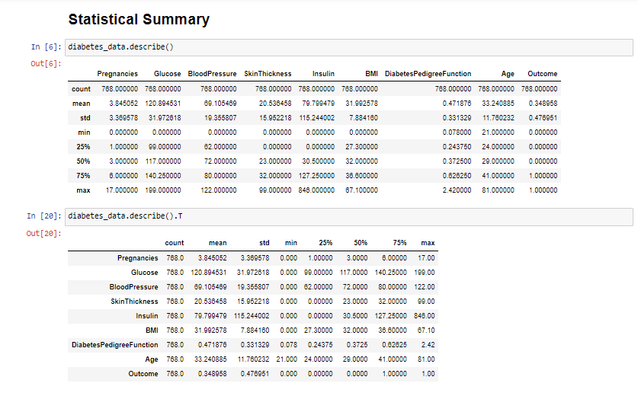
Statistical Summary

Slide 11
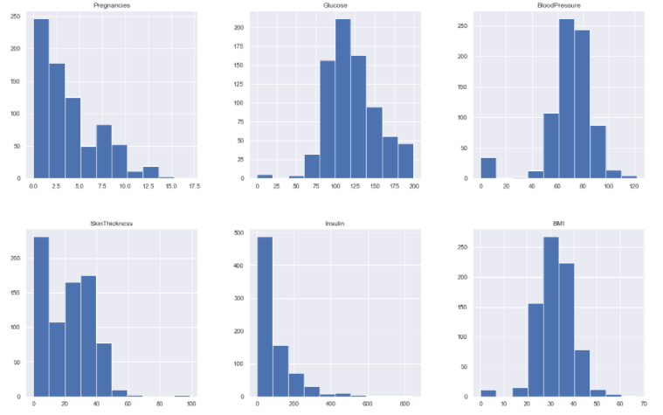
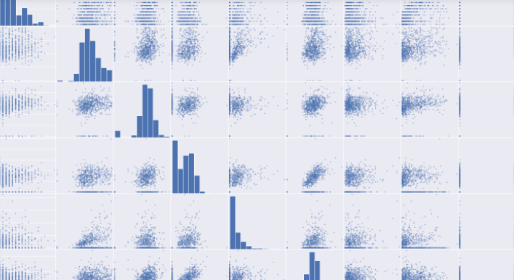
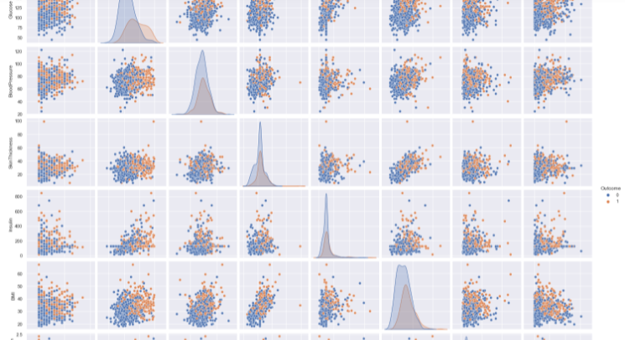
Data Visualization

Slide 12
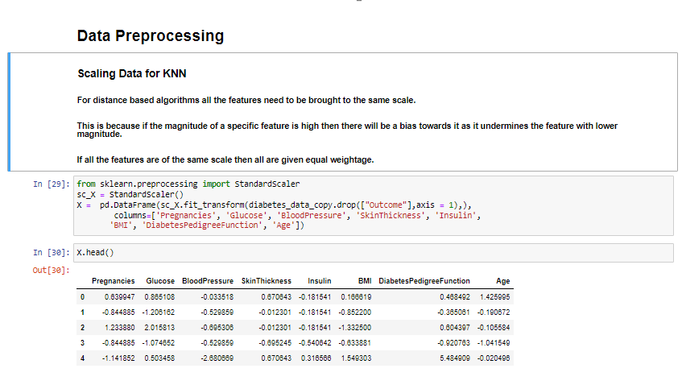
Data Pre-processing

Slide 13
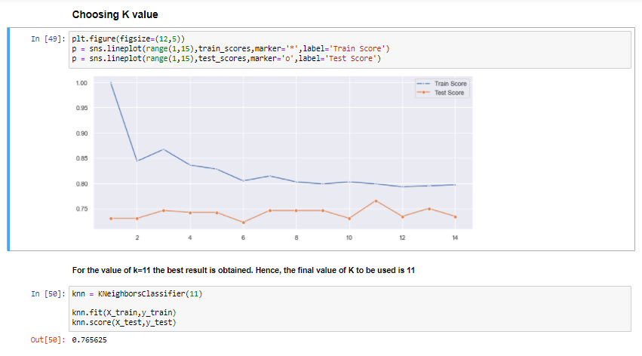
Selecting the value of K

Slide 14
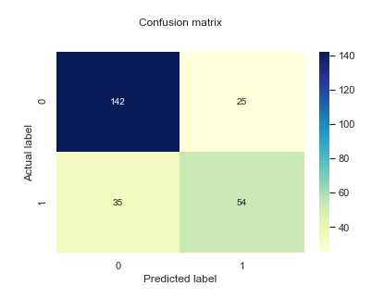
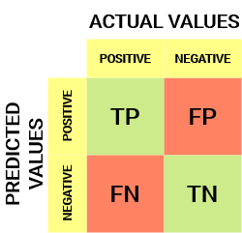
Confusion Matrix
A Confusion matrix is an N x N matrix used for evaluating the performance of a classification model.
The matrix compares the actual target values with those predicted by the machine learning model.

Slide 15
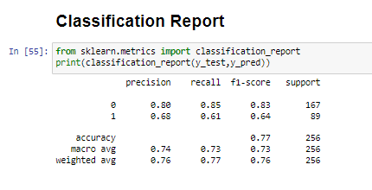
Classification Report

Slide 16
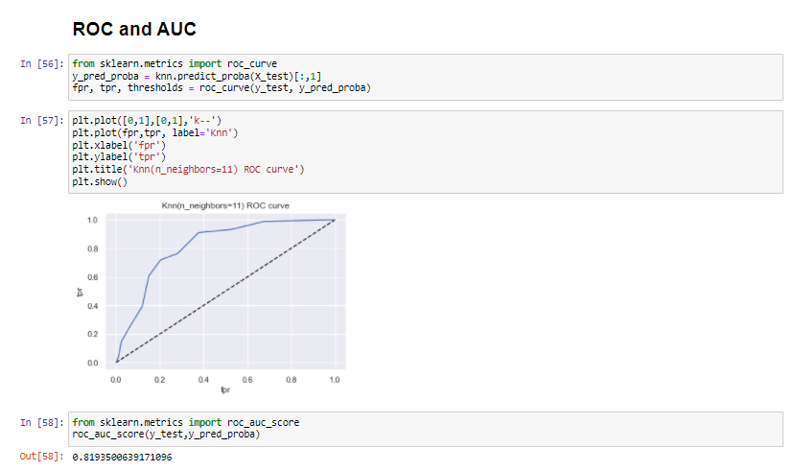
ROC AUC Curve
ROC is a probability curve and AUC represents the degree or measure of separability. It tells how much the model is capable of distinguishing between classes. Higher the AUC, the better the model is at predicting 0 classes as 0 and 1 classes as 1.

